Slide 1
View2022 Open Forums
Q2 2023
HR Compensation

Slide 2
What is View2022
View2022 is a classification and compensation study that will look at how the University defines and groups jobs, and determines the appropriate pay for work being completed. (Scope for Classified Staff Roles)
WHY NOW?
At the University, it has been many years since we’ve holistically reviewed our classification and compensation system. Current Structure was not producing our desired results.
IMPACTS?
No negative pay impacts
No changes to titles
All employees will have the opportunity to share feedback
Focus of View2022 is to build a Compensation structure that is consistent, sustainable, repeatable, and competitive.

Slide 3
Are we there yet?

Slide 4
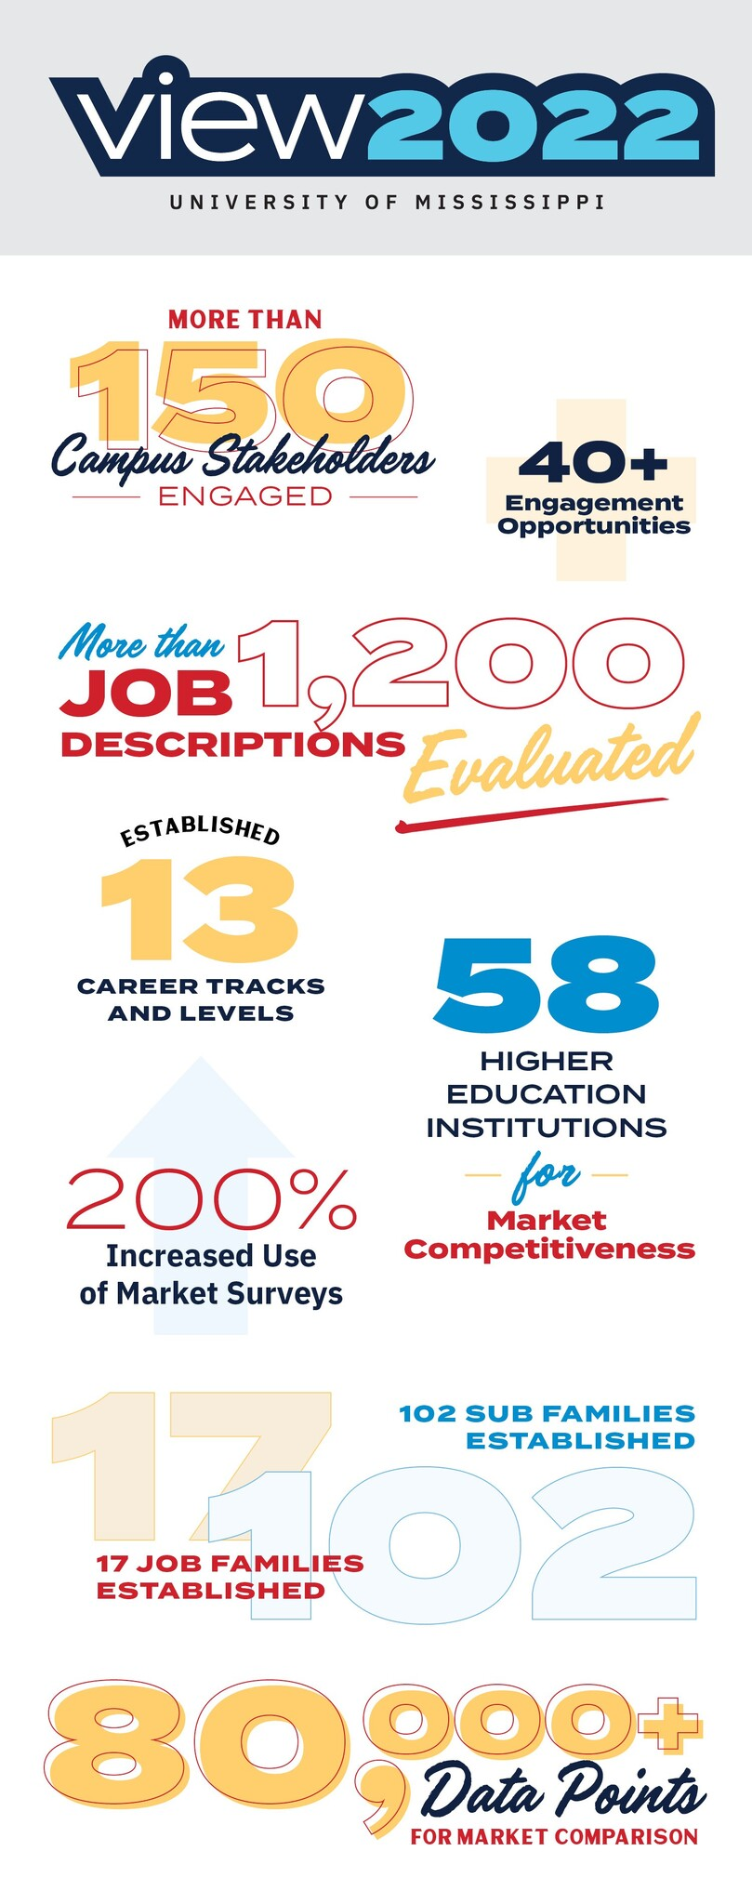
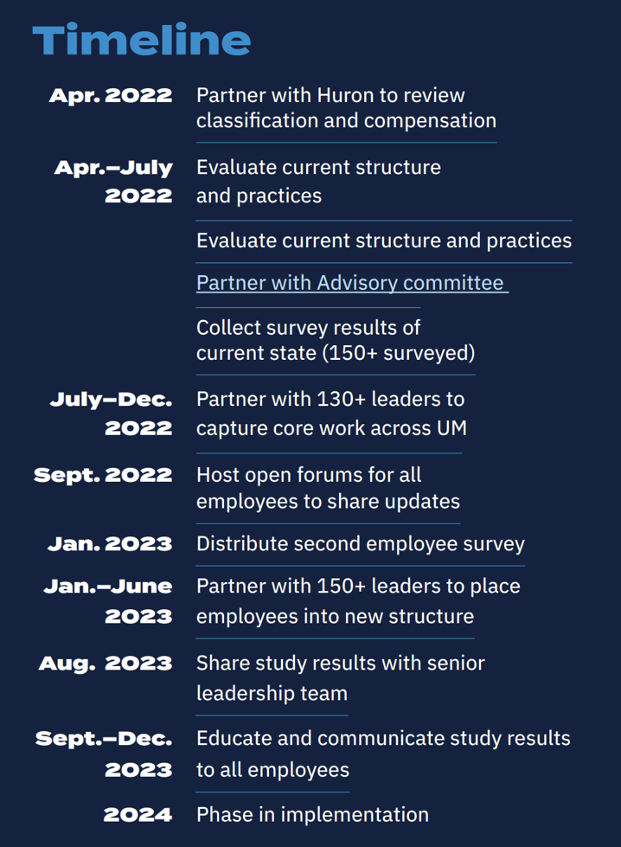
How we got to today
Build program
Structure Build
Employee Mapping
Role Pricing
Roll up Data
1 Year
Leadership Review
Structure & case study
Financial Meeting
Implementation
2 Months
Prepare Final Calibration
Clean and Prepare Data
Department specific
Start education and training
2 Months

Slide 5
Review of Structure
HR Compensation

Slide 6
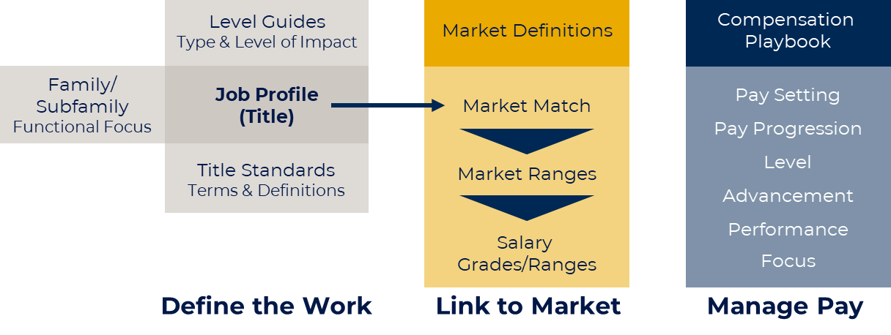
Compensation System Overview

Slide 7
Classification Structure Basic Principles
Start with the work, not the individual qualifications or where the job reports in the organization
Emphasize core responsibilities and duties, not inventory tasks
Distinguish people leadership roles (management) from higher level individual contributor roles
Emphasize “career progression” as movement across levels and across functions (vertically and laterally)
Allow for future expansion of the University within the framework

Slide 8
Classification Structure
17
102
3
13
Family
Subfamily
Career Track
Career Level
Job Family
Administration
Arts
Athletics
Communications and Marketing
Development and University Advancement
Education
Facilities Operations
Finance
Health Services
Human Resources
Information Technology
Legal and Compliance
Library and Museum
Public Safety
Research Administration
Research
Student & Academic Services
Finance
Accounting
Budgeting and Planning
Financial Support
Grant Accounting
Payroll
Procurement
Real Estate
Tax
Treasury
Operational Contributor | Operational Contributor I Operational Contributor II Operational Contributor III
Professional Contributor | Professional Contributor I Professional Contributor II Professional Contributor III Professional Contributor IV Professional Contributor V
Manager Leader | Manager I Manager II Manager III Manager IV Manager V
514 Job profiles
Human Resources
Benefits
Compensation
Employee Relations
HR Campus Partners
Learning and Development
Operations
Recruiting/Talent Acquisition
Administration
Administrative Operations
Administrative Strategy
Administrative Support
Customer Service
Program Coordination
Project Management

Slide 9
Examples
Department A | Total FTE - 51
Administration | 17
Communications and Marketing | 9
Education | 8
Facilities Operations | 4
Finance | 2
Information Technology | 6
Student & Academic Services | 5
Department A – Job Families | O2 | O3 | P1 | P2 | P3 | M2 | M4 | Total
Administration | 2 | 1 | 5 | 4 | 2 | 2 | 1 | 17
Communications and Marketing |  |  | 2 | 3 | 2 | 1 | 1 | 9
Education |  |  |  | 2 | 1 |  | 5 | 8
Facilities Operations |  | 2 |  | 1 |  | 1 |  | 4
Finance |  |  |  | 2 |  |  |  | 2
Information Technology | 1 |  | 2 | 1 | 1 | 1 |  | 6
Student & Academic Services |  |  | 1 | 3 | 1 |  |  | 5
TOTAL | 3 | 3 | 10 | 16 | 7 | 5 | 7 | 51

Slide 10
Examples
Dept B | Total FTE - 54
Administration | 17
Communications and Marketing | 7
Education | 13
Facilities Operations | 1
Finance | 4
Health Services | 1
Information Technology | 7
Library and Museum | 2
Research Administration | 1
Dept B – Job Families | O1 | O2 | P1 | P2 | P3 | P4 | M2 | M4 | Total
Administration | 3 |  | 4 | 4 | 2 |  | 3 | 1 | 17
Communications and Marketing |  |  | 1 | 2 | 2 | 1 | 1 |  | 7
Education |  |  | 2 | 4 | 5 |  | 1 | 1 | 13
Facilities Operations |  | 1 |  |  |  |  |  |  | 1
Finance |  | 3 |  |  | 1 |  |  |  | 4
Health Services |  |  |  |  | 1 |  |  |  | 1
Information Technology |  | 1 |  | 2 | 2 |  | 1 | 1 | 7
Library and Museum |  |  |  | 2 |  |  |  |  | 2
Research Administration |  |  |  |  | 1 |  |  |  | 1
TOTAL | 3 | 5 | 7 | 14 | 14 | 1 | 6 | 3 | 54

Slide 11
Compensation System Overview

Slide 12
Market Link Basic Principles
Focus on where we compete for talent.
Differentiate matching based on career track and function.
Select broad academic comparisons sets to provide more reliable data.
Add in general industry data for job families where it is relevant.
Create salary structure that allows pay movement within a range without always requiring classification changes.

Slide 13
Market Definition
The type of data used is determined by where the University competes for talent
Higher Education Only
Higher Ed / General Industry Blend
Job Family
Arts
Athletics
Development and Advancement
Education
Health Services
Library and Museum
Research Administration
Research
Student & Academic Services
Job Family
Administration
Communications and Marketing
Facilities Operations
Finance
Human Resources
Information Technology
Legal and Compliance
Public Safety

Slide 14
Market Definition – Data Cut
Data cut selection should vary by employee category using the compensation playbook for guidance
Complexity
Leadership and Management
Professional
Geography: Regional and National
Comparisons:
National General Industry;
Geography: Regional
Comparisons: Local/Regional General Industry
Geography: City/State
Support and
Operations
Comparisons: Local/Regional General Industry
Notes:
Again focus is on where we would find talent and lose talent.
This also helps bake in cost of living
Were not getting a custodian from Texas. We want to be competitive in oxford, Batesville, Memphis, tupelo that is where we will find people to fill those roles

Slide 15
Academic Peer Group
Relevant academic peers were selected based on standard criteria. Based on discussion with SLG in meeting 3/13/2023
R1+R2 Institutions (279)
R1 (146)
R2 Public (107)
High Undergraduate (82)
Adjustments (58)
Exclude enrollment >50K (total) and other outliers
Exclude Pacific, New England, and Mid-Atlantic
Adjust to add back peer 20 schools

Slide 16
Examples
Dept A | Market Def. | O2 | O3 | P1 | P2 | P3 | M2 | M4 | Total
Administration | Higher Ed & General Industry Blend | 2 | 1 | 5 | 4 | 2 | 2 | 1 | 17
Communications and Marketing | Higher Ed & General Industry Blend |  |  | 2 | 3 | 2 | 1 | 1 | 9
Education | Higher Ed Only |  |  |  | 2 | 1 |  | 5 | 8
Facilities Operations | Higher Ed & General Industry Blend |  | 2 |  | 1 |  | 1 |  | 4
Finance | Higher Ed & General Industry Blend |  |  |  | 2 |  |  |  | 2
Information Technology | Higher Ed & General Industry Blend | 1 |  | 2 | 1 | 1 | 1 |  | 6
Student & Academic Services | Higher Ed Only |  |  | 1 | 3 | 1 |  |  | 5
 |  | Local |  | Regional |  |  | National
Dept B | Market Def. | O1 | O2 | P1 | P2 | P3 | P4 | M2 | M4 | Total
Administration | Higher Ed & General Industry Blend | 3 |  | 4 | 4 | 2 |  | 3 | 1 | 17
Communications and Marketing | Higher Ed & General Industry Blend |  |  | 1 | 2 | 2 | 1 | 1 |  | 7
Education | Higher Ed Only |  |  | 2 | 4 | 5 |  | 1 | 1 | 13
Facilities Operations | Higher Ed & General Industry Blend |  | 1 |  |  |  |  |  |  | 1
Finance | Higher Ed & General Industry Blend |  | 3 |  |  | 1 |  |  |  | 4
Health Services | Higher Ed Only |  |  |  |  | 1 |  |  |  | 1
Information Technology | Higher Ed & General Industry Blend |  | 1 |  | 2 | 2 |  | 1 | 1 | 7
Library and Museum | Higher Ed Only |  |  |  | 2 |  |  |  |  | 2
Research Administration | Higher Ed Only |  |  |  |  | 1 |  |  |  | 1
 |  | Local |  | Regional |  |  |  | National

Slide 17
Pay Structure Basic Principles
Create ranges for both hiring and salary adjustment
Pay structure will be regularly updated based on movement of the market

Slide 18
Pay Structure
The proposed pay grade structure is based on a standard progression of range medians and increasing widths.
Grade | Minimum (Hourly) | Midpoint (Hourly) | Maximum (Hourly) | Progression | Spread
1 | $14.00 | $17.50 | $21.00 | 10% | 50%
2 | $15.40 | $19.25 | $23.10 | 10% | 50%
3 | $16.94 | $21.18 | $25.41 | 10% | 50%
4 | $18.63 | $23.29 | $27.95 | 10% | 50%
5 | $20.50 | $25.62 | $30.75 | 10% | 50%
6 | $22.55 | $28.18 | $33.82 | 10% | 50%
7 | $24.80 | $31.00 | $37.20 | 10% | 50%
8 | $27.28 | $34.10 | $40.92 | 10% | 50%
9 | $30.01 | $37.51 | $45.02 | 10% | 50%
10 | $33.01 | $41.26 | $49.52 | 10% | 50%
11 | $36.31 | $45.39 | $54.47 | 10% | 50%
12 | $39.94 | $49.93 | $59.92 | 10% | 50%
(Grades are continued further as necessary.)

Slide 19
Move through grade
Employees can move through the pay range for their role at different rates and speeds
First Quartile​ | Second Quartile​ | Third Quartile​ | Fourth Quartile​
Meet minimum qualifications but require additional training and closer supervision for full proficiency.​ | Experienced employees who are fully proficient and consistently meet expectations with minimal guidance.​ | Well-qualified individuals (preferred qualifications) who are expected to contribute to a higher degree of proficiency | Highly skilled and experienced employees, expected to consistently contribute at the highest level to UM.​ ​ UM HR approval required.​
Progression based on applied education, experience and consistency of contribution

Slide 20
Compensation System Overview

Slide 21
Administration Basic Principles
Establish Human Resources as the custodian of data and analysis related to compensation
Establish standards for pay adjustments by type
Provide flexibility for leaders to make decisions within parameters (e.g., adjustments within ranges)
Move towards workforce planning model that integrates talent, compensation, and budget planning

Slide 22
Guiding Principles
What we constantly reference to ensure our decisions align. If we are making decision that do not align to these guiding principles, we need to step back and re-evaluate.
Clarity Through Transparency
Process Consistency
Work-Driven Compensation
Internal Equity
Leadership Accountability

Slide 23
Roles and Responsibilities
The Compensation Team will focus on maintaining the integrity of the new system and providing consultative support to managers and leaders.
Human Resources | Direct Supervisors | Leadership
Continuous system and structure maintenance Data analysis Strategic partner with leadership Build tools and resources to support autonomy Classification decisions | Front line compensation support Identify risks within team Attend training related to talent management and apply concepts | Identify talent management priorities / strategy Identify strategic and essential positions Ensure that equity is maintained within the college/division Participate in annual workforce planning (future)

Slide 24
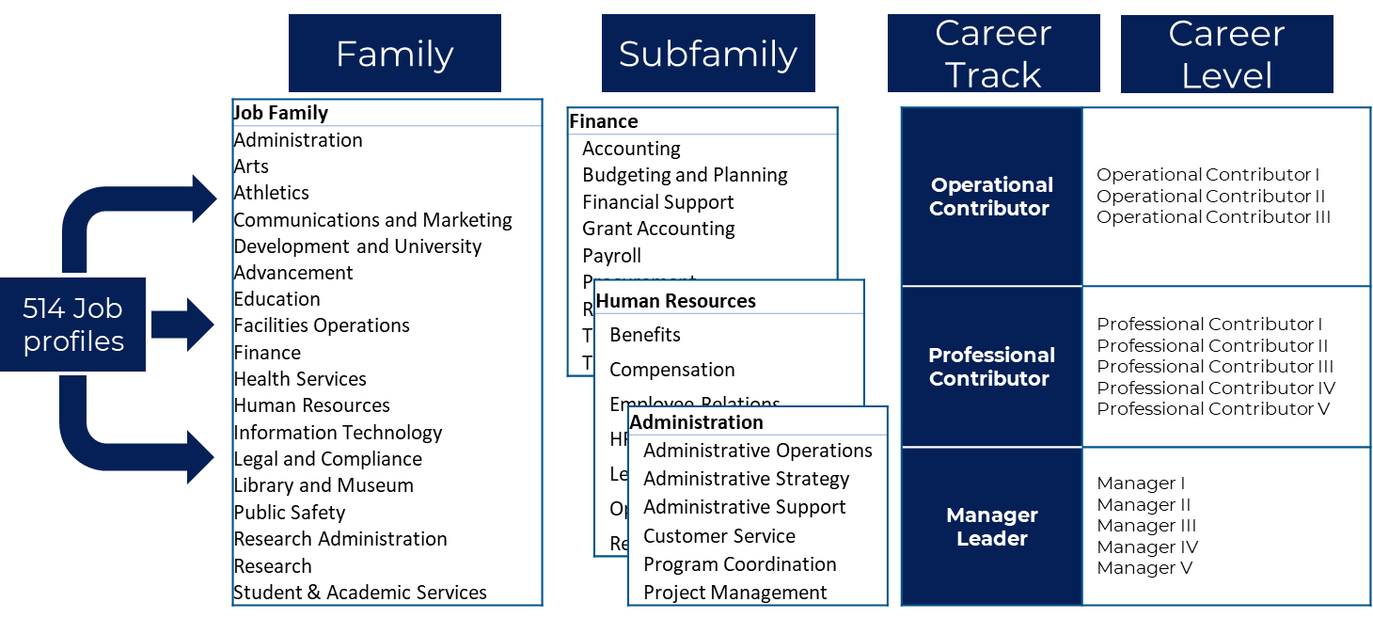
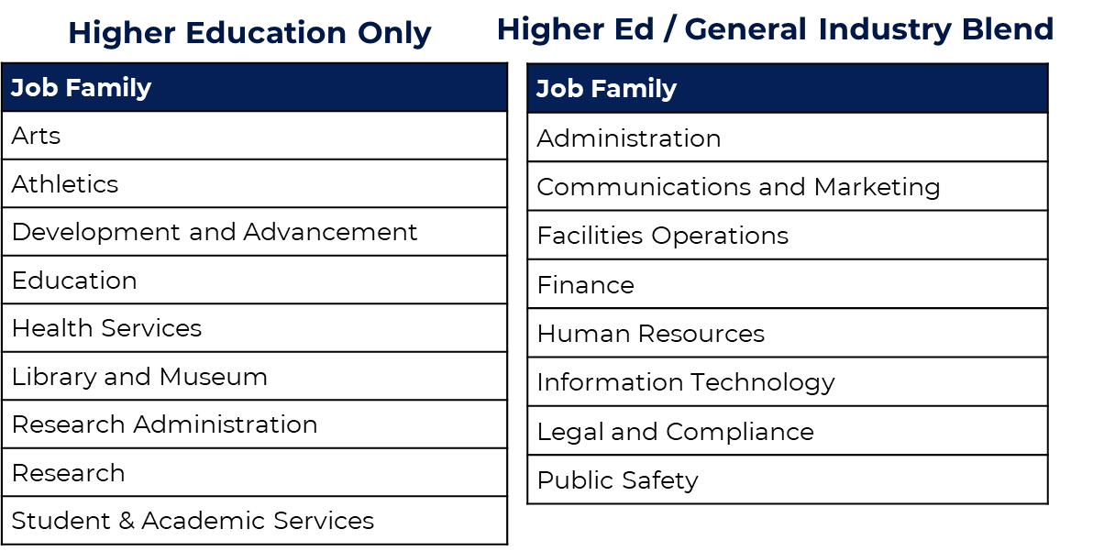
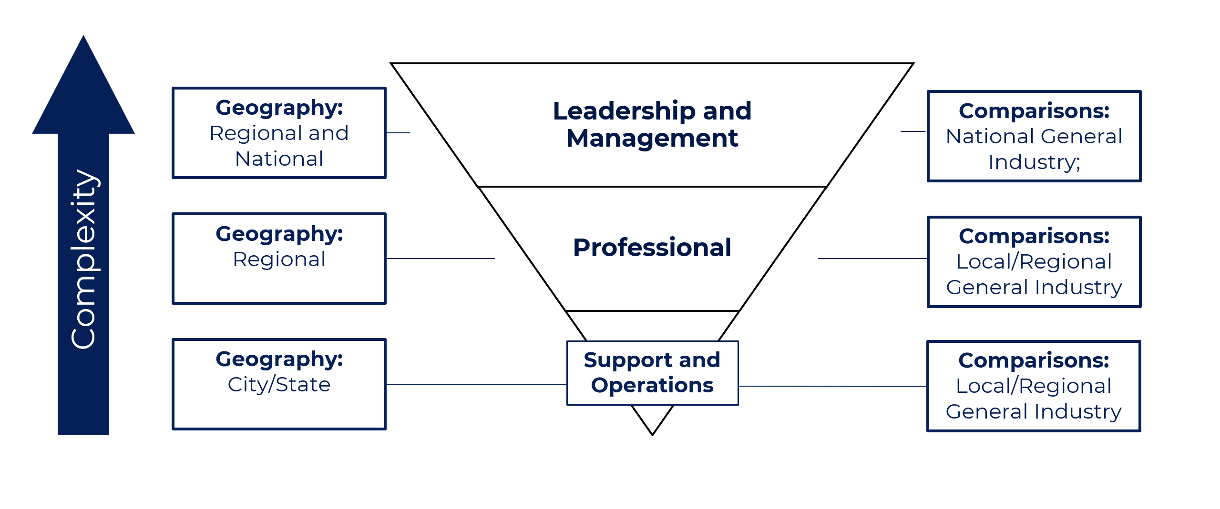
How we set pay
UM Job Profile | Salary Survey | Market Med
Job A | CUPA | $54,246
Job A | General Industry | $69,992
50/50 Blend | Blend | $62,129
Organize the Work
Link to Market
Market Median Pay Identified
Grade | Min | Mid | Max
1 | $29,120.00 | $36,400.00 | $43,680.00
2 | $32,032.00 | $40,040.00 | $48,048.00
3 | $35,235.20 | $44,054.40 | $52,852.80
4 | $38,750.40 | $48,443.20 | $58,136.00
5 | $42,640.00 | $53,289.60 | $63,960.00
6 | $46,904.00 | $58,614.40 | $70,345.60
7 | $51,584.00 | $64,480.00 | $77,376.00
8 | $56,742.40 | $70,928.00 | $85,113.60
51.8k – 58k
58k – 64.4k
64.4k – 70.9k
70.9k – 77.3k
Placement / Movement
Using Quartile System
Placed into Pay Structure

Slide 25
Adjustment By Type
Pay can be adjusted based on a number of factors, but each one has definitions and standards.
Base Pay
Reflects the market and internal valuation of job
Pay Positioning
Reflects value of individual skills, qualifications, or sustained applied experience within a job
Additional Pay
Reflects additional time or effort outside standard job expectations
Performance Pay
Recognizes the annual impact and contribution of an individual relative to expectations.
Market Adjustment
Promotion
Reclassification
Equity Adjustment
Qualifications Adjustment
Retention Adjustment
Overtime
Shift Differential
Interim Roles
Special Assignments
Additional Jobs
Occasional Additional Services
Annual Pay Program tied to meeting or exceeding expectations.

Slide 26
Next Steps
HR Compensation

Slide 27
Timeline
Timeline is an estimate and could move faster or be delayed based on many factors.
Our goal from the beginning and still today is to move fast while balancing change management. (speed and direction) Ensure before we move into the new compensation program we feel confident employees have been heard, and leaders are trained and educated.
FY24 - Q2 (Oct – Dec)
Finalize calibration
FY24 - Q3 (Jan – March)
Finalize implementation plan
Educate and train leaders
FY23 Q3/Q4
Start implementing new program (likely in phases)

Slide 28
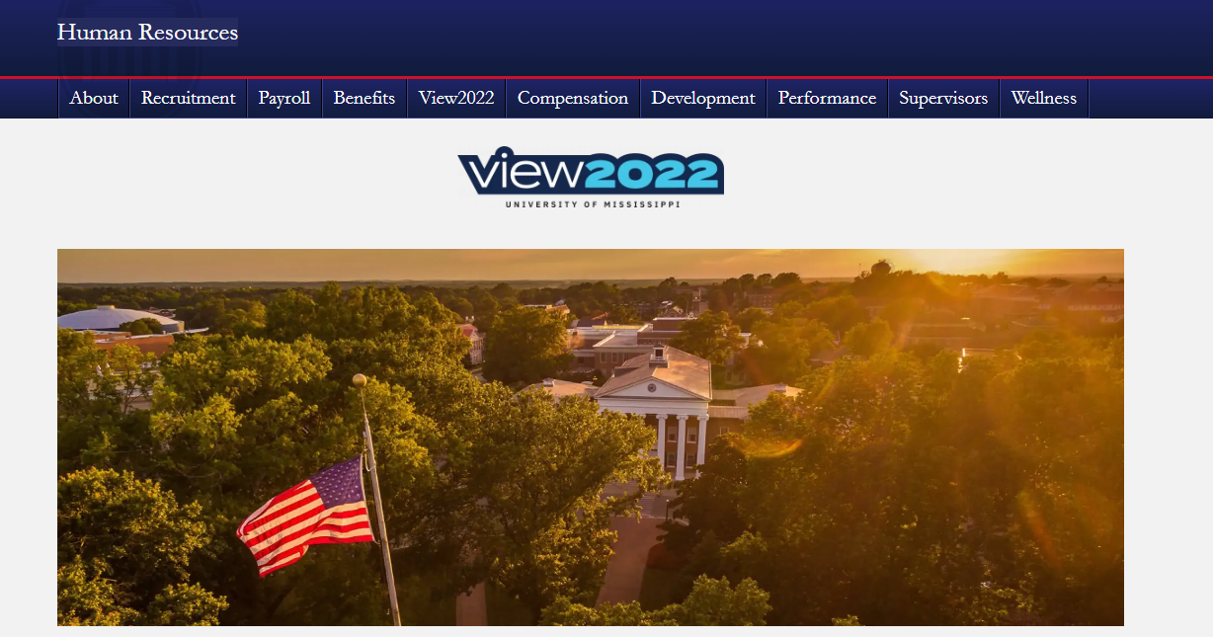
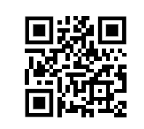
Best Way to Stay Engaged?
Visit the View2022 Website
Connect with your leadership*
Check UMToday
Check Red & Blue Newsleter
https://hr.olemiss.edu/

Slide 29
Open Discussion
HR Compensation
Notes:
Topics from Pulse Survey

